Slide 1

Productive4.0 WP1 Workshop – together with Arrowhead Tools
Productive4.0
Some Arrowhead Basics
WP1, 12.11.2019
Porto, Portugal
Pal Varga Budapest University of Technology and Economics

Slide 2
Some Basic Principles of Arrowhead
Arrowhead: Interoperabity and Integrability
Local Automation Clouds
Service Oriented Architecture
Authorization with Certificates
Varios Multi-clouds: Edge, Platform, Enterprise
Inter-Cloud Orchestration
Arrowhead Relays
Maturity Levels for Integrability – hardware and software adaptors

Slide 3
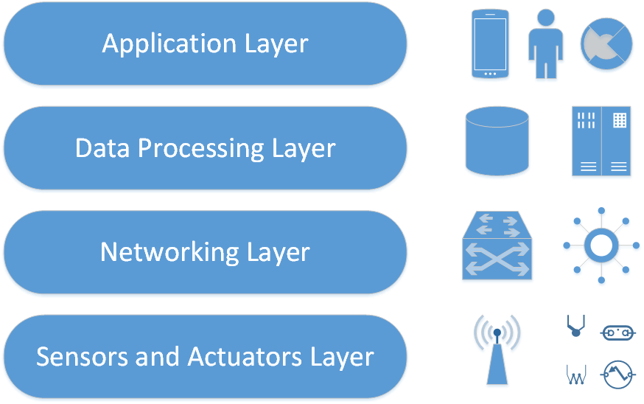
Layered structure of IoT systems (one approach…)

Slide 4
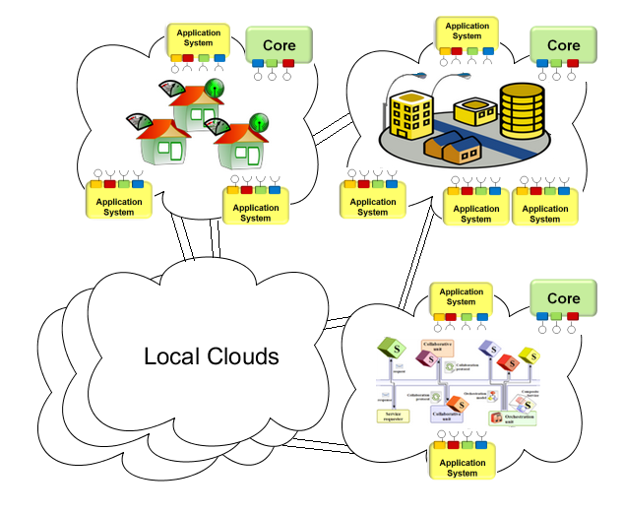
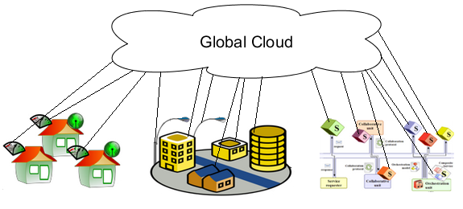
Local Automation Clouds
-> advantages

Slide 5
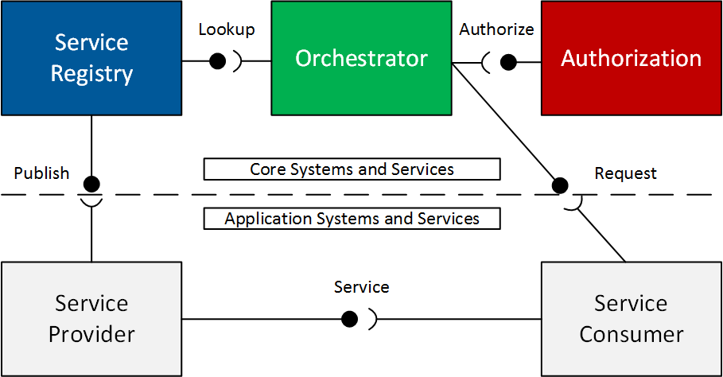
Arrowhead Framework
Core Components
Minimum working set
Some of the further elements
Notes:
Introduction and goals of AH
Local Clouds work in SOA.
There are the mandatory core systems, that offer basic governance.
Authorization now bears two tasks: access control information, token gen.
SR: now capable of cleaning up the database, implements service metadata with every offering separately.
Gatekeeper has two services: GSD, ICN.
Network Manager will be required to build up inter-cloud data end-to-end path.

Slide 6
Orchestration Service
(vs OrchestrationStore)

Slide 7
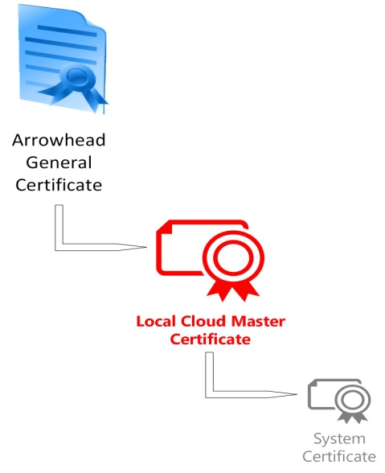
X.509 Certificates: Chain of Trust
AH Master CA
Cloud 1 CA
Cloud 2 CA
System A Certificate
System B Certificate
…
System M Certificate
System N Certificate
System O Certificate
…
System X Certificate

Slide 8
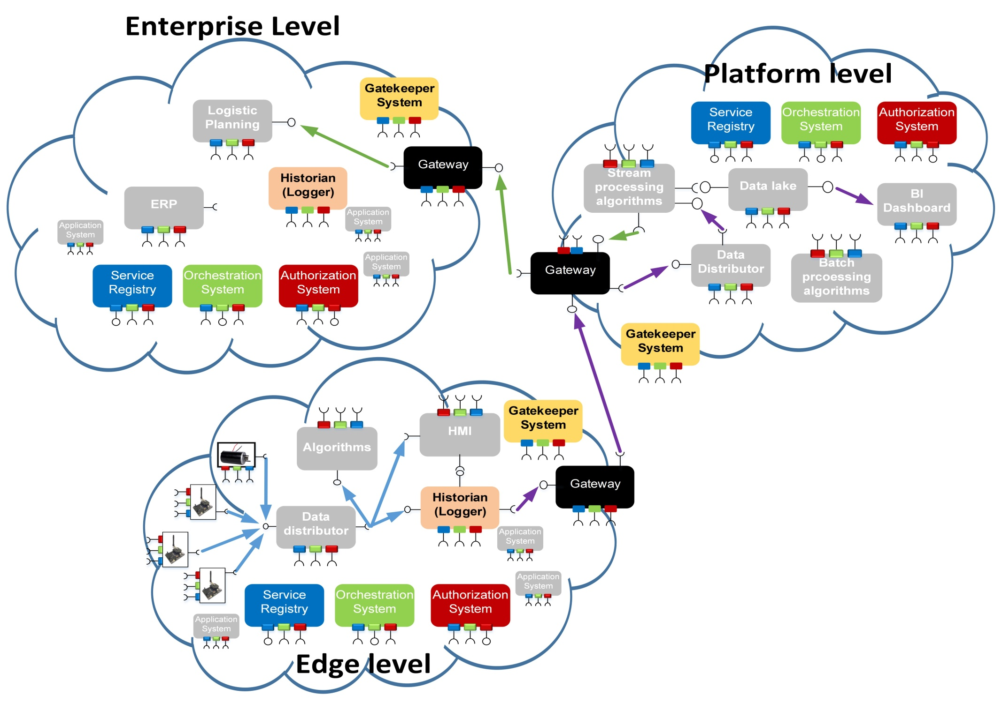
Multi-level service exchange

Slide 9
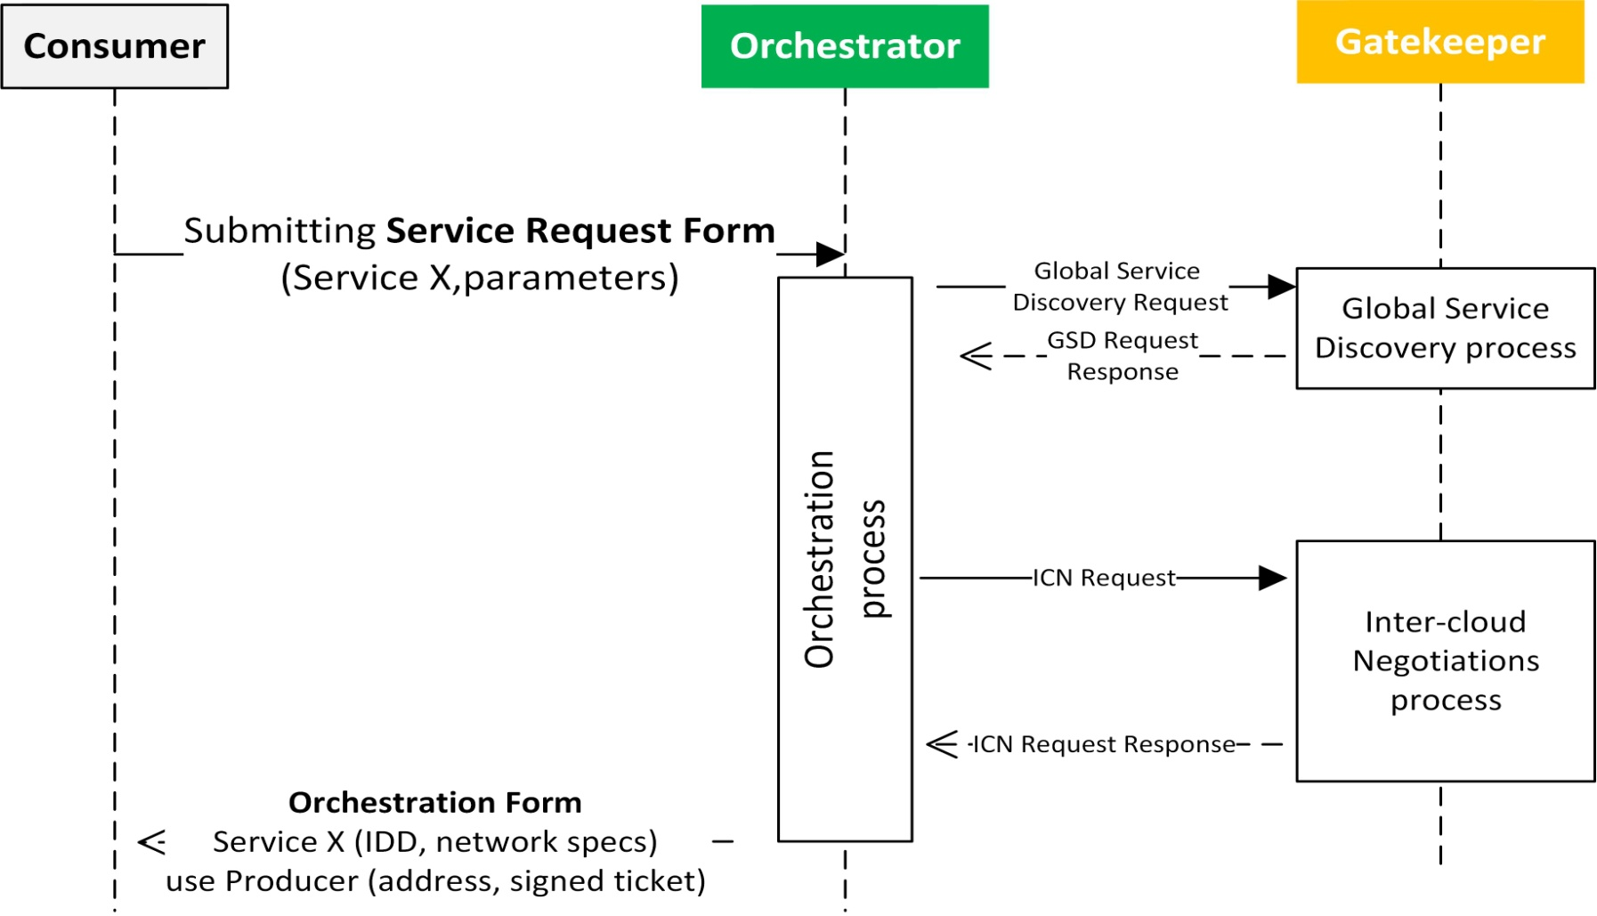
Inter-Cloud orchestration process
Service Request from the
Application System
Local Cloud Orchestration
Global Service Discovery
Choosing the Partnering Cloud
Inter-Cloud Negotiations
Forwarding the
Entry Token
Application System connects to the
Partnering Cloud

Slide 10
Arrowhead Brokers / Relays
This tunneling is implemented using ActiveMQ brokers
ActiveMQ Broker
Local Cloud „A”
Local Cloud „B”
2
3
7
6
Authorisation
Gateway
Gateway
Authorisation
4
Orchestration
5
1
8
Service Registry
Provider
Service Registry
Gatekeeper
Gatekeeper
Consumer
Orchestration

Slide 11
The complete Inter-Cloud orchestration process
1: Service Request
2: GSD and then ICN Init
3: ICN Proposal
4: Service Request (remote)
5: ConnectToProvider
6: ICN Response
7: ConnectToConsumer
8: Orchestration Response
9: Application Service Call
10-11: TCP tunneling
12: Application Service Call

Slide 12
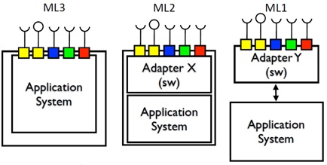
Maturity Levels of Arrowhead Integration

Slide 13
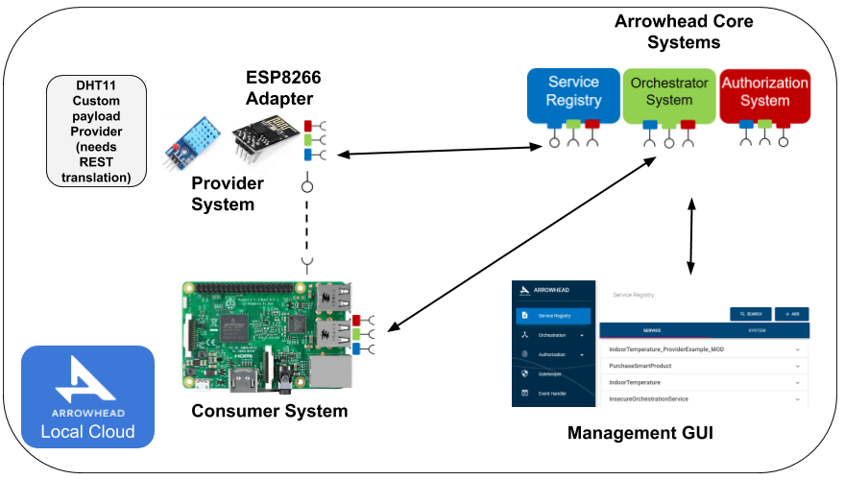
An example for Maturity Level 1

