Slide 1
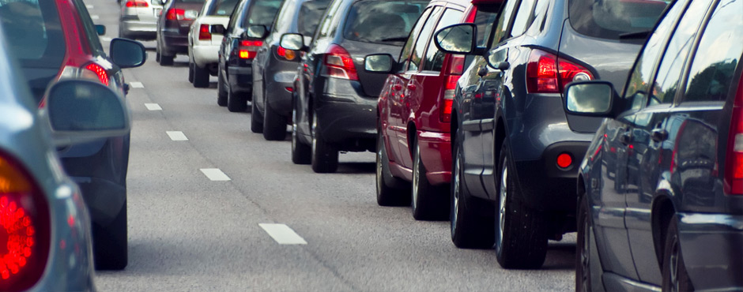

Mobility and VANETs
Intelligent Transportation Systems
Rolland Vida

Slide 2
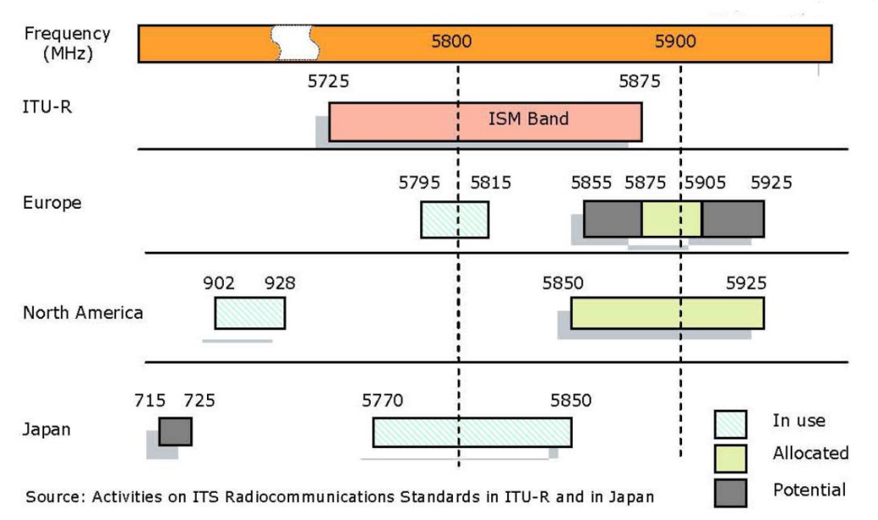
DSRC – Dedicated Short Range Communications
Dedicated in 1999 by the FCC (Federal Communications Commission) to vehicular communications
  75 MHz of spectrum in the 5.9 GHz band (5.850-5.925 GHz)
In Europe, ETSI allocated in 2008 30 MHz in the 5.9 GHz band for ITS
Systems in US, Europe, Japan not really compatible with each other

Slide 3
DSRC – Dedicated Short Range Communications
Traditional ISM bands (Industry, Science, Medical) – 900 MHz, 2.4 GHz, 5 GHz
  Free, unlicenced bands
  Populated by many technologies – Wifi, Bluetooth, Zigbee
  No restrictions other than some emmission and co-existance rules
DSRC band
  Free but regulated spectrum
  Restrictions in terms of usage and technologies
  All radios should be compliant to a standard

Slide 4
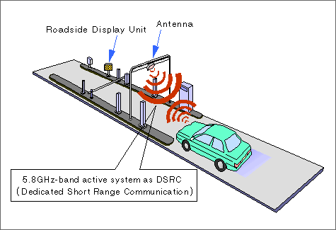
DSRC – Dedicated Short Range Communications
Basic goals of DSRC
  Support of low latency, secure transmissions
  Fast network acquisition, rapid and frequent handover handling
  Highly robust in adverse weather conditions
  Tolerant to multi-path transmission
Mainly for public safety applications, to save life and improve traffic flow
Private services also permitted
  Spread the deployment costs, encourage quick development and adoption
  Electronic Toll Collection (ETC) was initially one of the main drivers

Slide 5
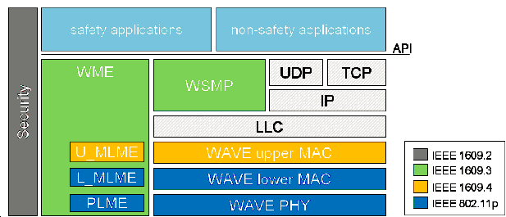
WAVE
IEEE 802.11
  Collection of physical (PHY) and medium-access control (MAC) layer specifications for implementing WLAN
  802.11a (5 GHz, OFDM), 802.11b (2.4 GHz, DSSS), 802.11g (2.4 GHz, OFDM), 802.11n (2.4 and 5 GHz, MIMO-OFDM), 802.11ac (5 GHz, MIMO-OFDM)
  802.11p – part of WAVE (Wireless Access in Vehicular Environment)
WME – WAVE Management Entity
PLME – Physical Layer Manag. Entity
MLME – MAC Layer Manag. Entity
LLC – Logical Link Control
WSMP – WAVE Short Message Prot.

Slide 6
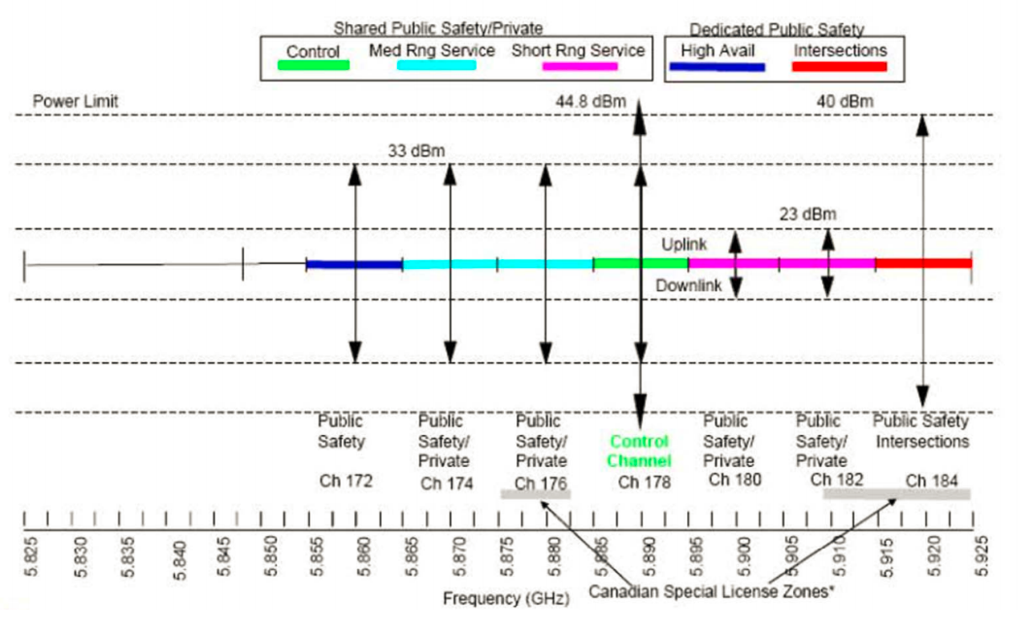
WAVE spectrum bands
75 MHz wide spectrum divided into 7x10 MHz wide channels, 5 MHz guard band
  Channel 178 the control channel (CCH) - transmit WAVE Short Messages (WSM), announce services
  Channel 172 reserved for high availability applications (future use)
  Channel 184 reserved for intersections
  The other channels shared between public safety and private uses
    Channels 174-176 and 180-182 can be
    combined to form a 20 MHz channel
In Europe the ITS-G5 standard
  ITS-G5B band: 5.855 – 5.875 GHz
    172, 174 SCH – ITS non-safety app
  ITS-G5A band: 5.875 – 5.905 GHz
    176, 178 SCH – ITS traffic safety app
    180 CCH
  ITS-G5D band: 5.905 – 5.925 GHz
    182, 184 SCH – for future use

Slide 7
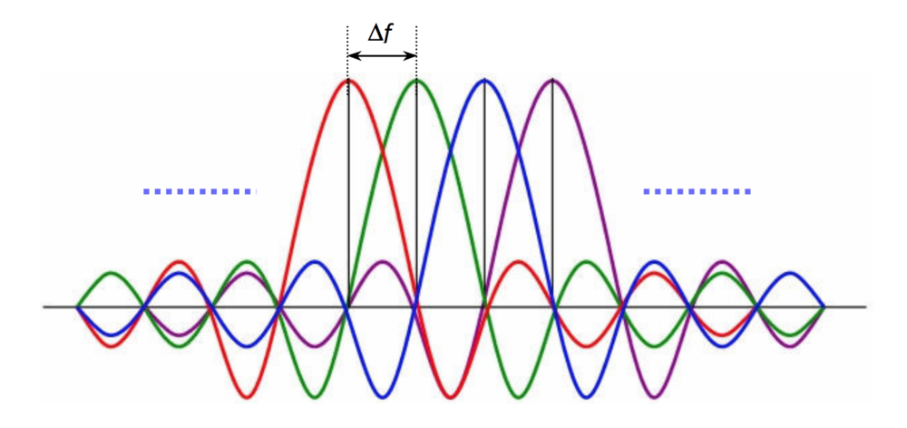
WAVE (802.11p) vs IEEE 802.11
10 MHz channels instead of 20 MHz
3-27 Mbps instead of 6-54 Mbps
Same modulation schemes (BPSK, QPSK, 16QAM, 64QAM)
Carrier spacing reduced to 0.15625 MHz from 0.3125 MHz
  48 data subcarriers for both

Slide 8
Traditional IEEE 802.11 MAC (DCF)
DCF – Distributed Coordination Function
  A sends an RTS frame to B, asking the permission to send a data frame
    Request To Send
  If B gives the permission, it sends back a CTS frame
    Clear To Send
  A sends the data frame, and starts an ACK timer
    If B receives the packets in order, it replies with an ACK frame
    If the timer expires without receiving an ACK, everything starts
    from scratch
Data
RTS
C
B
D
A
CTS
ACK
8

Slide 9
Traditional IEEE 802.11 MAC (DCF)
C hears A, receives the RTS frame
  Deduces that in the next moments someone will start to send data
  It stops its own transmission, while the other conversation is not finished
    Knows when it ends from the ACK timer, included in the RTS frame
  It sets an internal reminder to himself, saying that the channel is virtually occupied
    NAV – Network Allocation Vector
D does not hear about the RTS, but hears the CTS
  Also sets a NAV for himself
C
A
B
D
NAV
RTS
Data
CTS
ACK
NAV

Slide 10
Traditional IEEE 802.11 MAC (PCF)
PCF – Point Coordination Function
  An Access Point controls the access to the wireless channel
    No collisions
  The AP polls the other stations, to find out who has data to send
    The standard defines only some basic features of the poll
      Does not define the frequency, or the order in which different stations are polled
      Does not ask for equal treatment for all the stations
  The AP periodically sends a beacon frame
    10-100 beacons / s
    It contains system parameters
      Hopping sequence and dwell times (for FHSS), clock synchronization, etc.
    New stations are invited to participate in the polling

Slide 11
Traditional IEEE 802.11 MAC (DCF & PCF)
PCF and DCF can operate in parallel inside the same cell
  Distributed and centralized control in the same time?
    Is possible, if carefully defined timers are used
    After the sending of a frame, a certain guard time is required before any other transmission
Four specific timers
  SIFS – Short Inter-Frame Spacing
    The shortest spacing, to support those devices that currently occupy the channel for a short conversation
    After the SIFS, a receiver can send a CTS to an RTS
    After the SIFS, a receiver can send an ACK for a given part of the data frame
    A new part can be sent, without a new RTS
Here we can send a new control or data frame
SIFS
ACK
Time

Slide 12
Traditional IEEE 802.11 MAC (DCF & PCF)
PIFS – PCF Inter-Frame Spacing
  After an SIFS, only one specific station can send
  If nothing is sent until the end of the PIFS, the AP has the possibility to take over the channel, and send a new beacon or a polling frame
    An ongoing conversation can be finished without disturbing it
    The AP can access the channel without a contention
      No contention with the greedy users
Here we can send a new control or data frame
SIFS
Here the AP sends a PCF frame
PIFS
ACK
Time

Slide 13
Traditional IEEE 802.11 MAC (DCF & PCF)
DIFS – DCF Inter-Frame Spacing
  If the AP does not have anything to send, after the DIFS anyone can try to gain access to the channel
    Usual contention rules
    Exponentially increasing back off interval, if collision
  Same DIFS value for all traffic types
EIFS – Extended Inter-Frame Spacing
Here we can send a new control or data frame
SIFS
Here the AP sends a PCF frame
PIFS
Here one can send a DCF frame
DIFS
Here can we report the errors
EIFS
ACK
Time

Slide 14
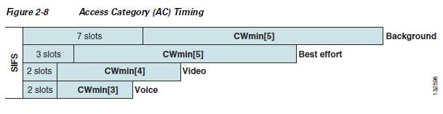
802.11e MAC - Enhanced Distributed Coordination Access (EDCA)
  To support Quality of Service differentiation
  Arbitration Inter-Frame Spacing to replace the static DIFS
    Different values for each Access Category
    AIFS = 1 SIFS + AIFSN * slot time
    By default…
      Voice Queue (AIFSN=2) 1 SIFS + 2 * slot time
      Video Queue (AIFSN=2) 1 SIFS + 2 * slot time
      Best Effort Queue (AIFSN = 3) 1 SIFS + 3 * slot time
      Background Queue (AIFSN = 7) 1 SIFS + 7 * slot time
    When AIFS expires, choose a random value between 0 and CWmin (minimum contention window)
    Start decrementing a backoff timer
    If another node starts transmitting, access is deferred until the channel is free again
    Then backoff timer decrementation is resumed from where it was stopped
    If backoff = 0, transmission starts
    If collision, no ACK received – CWmin is doubled until it reaches CWmax

Slide 15
802.11p MAC
Enhanced Distributed Coordination Access (EDCA)
  Defined in IEEE 802.11e, to support Quality of Service differentiation
    In 802.11e four Access Categories (AC)
      Voice, Video, Best Effort and Background
    In 802.11p ACs to differentiate between:
      safety critical and non-safety applications

Slide 16
802.11p beaconing
Basic Service Set in traditional IEEE 802.11
  Multiple handshakes to ensure distributed medium access
Wave Basic Service Set (WBSS) in 802.11p
  A node broadcasts a beacon, to advertise its WBSS
  What kind of services it supports, how to join the WBSS
Within the WBSS, nodes exchange beacons using the Wave Short Message Protocol (WSMP)
  To create cooperative awareness
  Information on speed, position, acceleration, direction
  Sent at regular intervals (e.g., 10 Hz – 100 ms)
Sent on the CCH, no ACK
  After the channel is sensed free for AIFS
  If not free, backoff for the size of a Contention Window, and try again
  No doubling of the contention window
As opposed to data sent on SCH, where ACK should be sent
  If no ACK received, collision occured, contention window doubled

Slide 17
IEEE 1609.x
IEEE 1609.2 – security services
IEEE 1609.3 – management services
  Channel usage monitoring
  Received channel power indicator (RCPI)
  Management parameters
IEEE 1609.4 – QoS and multi-channel access
  User Priorities mapped to Access Categories in EDCA
  Multi-channel access for single radio 802.11p devices

Slide 18
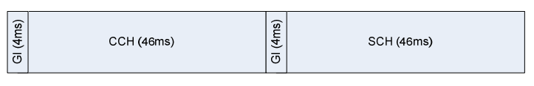
IEEE 1609.4 channel swithcing
7 FDMA channel frequencies
Multi-channel radios can send and receive over several channels simultaneously
Single channel radios to access both CCH and SCH
  Either transmit or receive on a single 10 MHz channel
Alternating access
  Repetitive periods of 100 ms
    46 ms allocated to the CCH channel
    46 ms allocated to the SCH channels
    4 ms guard interval for switching between CCH and SCH
      Nodes should wait for a random backoff after the end of the guard interval, before starting to transmit
  Time synchronisation needed to an external time reference
    Coordinated Universal Time (UTC) from GPS or other devices
      WAVE Time Advertisement (WTA) frame

Slide 19
IEEE 1609.4 channel switching
Continuous access
  Transmission can be continuous on the CCH and all SCHs
  It cannot be guaranteed that all other stations will listen to the CCH outside the CCH slot
  Safety messages sent over the CCH in the SCH slot might be ineffective
  The usage of SCH not efficient if nodes listen to the CCH 50% of the time
Alternative solutions to minimise the impact of channel switching?

Slide 20
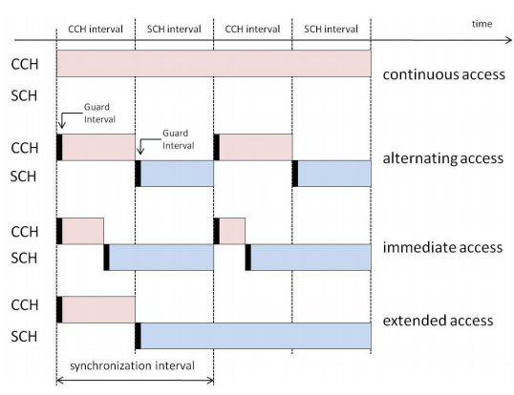
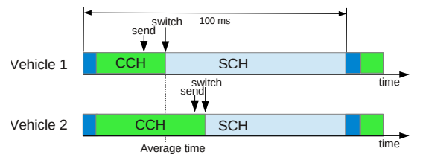
IEEE 1609.4 channel switching
Immediate access
  The node does not have to wait until the CCH slot is over
  After the CCH transmission is over, switch to SCH
  Improve the performance of bandwidth-demanding non-safety
  applications in SCH, at the expense of the CCH
Extended access
  Transmission on the SCH without waiting for the CCH
Adaptive Independent Channel Switching
  If more vehicles, more beacons on the CCH
  Nodes can change their average switching time based on vehicle density
    Long SCH intervals if not many vehicles
    Fewer collisions at the start of the SCH, as nodes switch independently of each other
  Drawback is that not all nodes on the CCH in the same time
    Vehicle 1 will miss the beacon of Vehicle 2

Slide 21
IEEE 1609.4 channel switching
Fragmentation
  To better utilise the residual time at the end of the SCH interval
  An extra fragmentation header should be used, which is a drawback
  Works for large packets (TCP)
Best-fit scheme
  Send the packet that best fits the residual time at the end of the SCH interval
    Better than fragmentation only if packets of different sizes are present in the queue
  Hard to know in advance the actual duration of transmission
    Frequent changes in the channel congestion
    Stochastic nature of backoff

