Slide 1
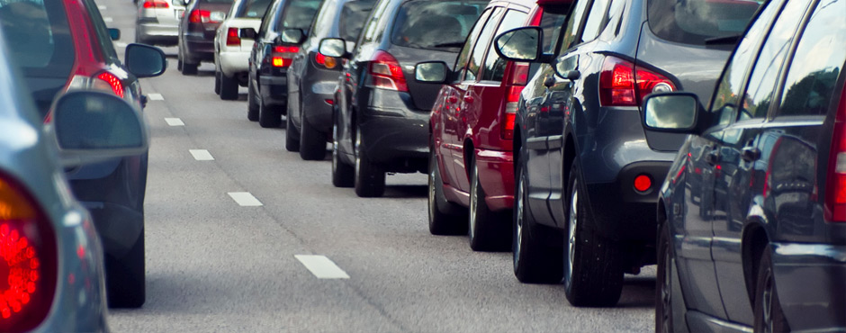
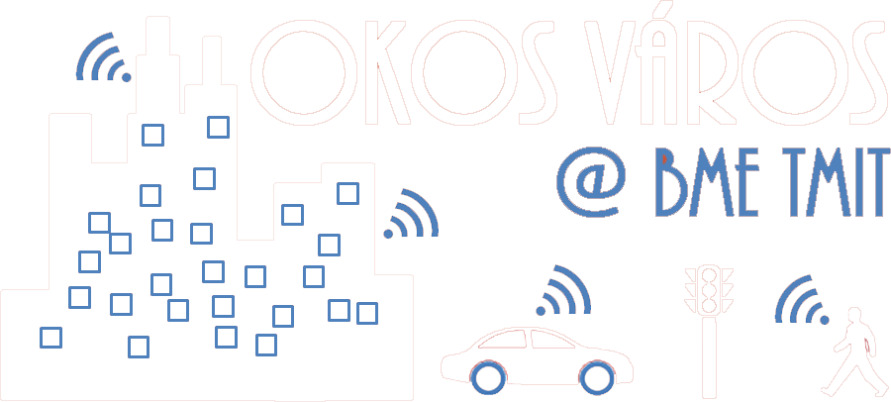
Mobility and VANETs
Intelligent Transportation Systems
Rolland Vida

Slide 2
DTN: Delay Tolerant Network
If nodes are sparse, the network connectivity can be broken
Topology holes will appear
This can be handled by the carry-and-forward method
  Data-mules
It is possible if the message is still valid in spite of the delay
Mobility prediction is very useful

Slide 3
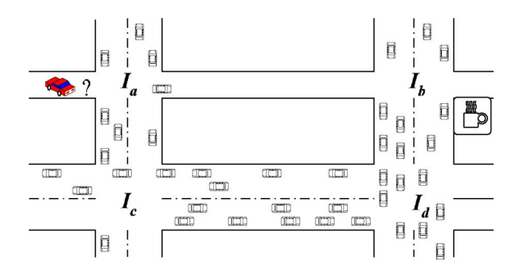

VADD: Vehicle-Assisted Data Delivery in VANET
Carry-and-forward, optimized to the lowest delivery delay
  Prefers radio links, as they are faster than using data mule cars
  If data has to be carried by a car, it chooses the fastest car that goes in the good direction
  Dynamic routing step by step
  VADD delay model
    Distances between intersections
    Average vehicle density on each segment
    Average vehicle speed on each segment
  Stochastic model
    We cannot calculate in advance the entire path
    It depends on whether in a given intersection, at a given moment there will be a car to forward the message in a given direction, or not
    We can calculate probabilities

Slide 4
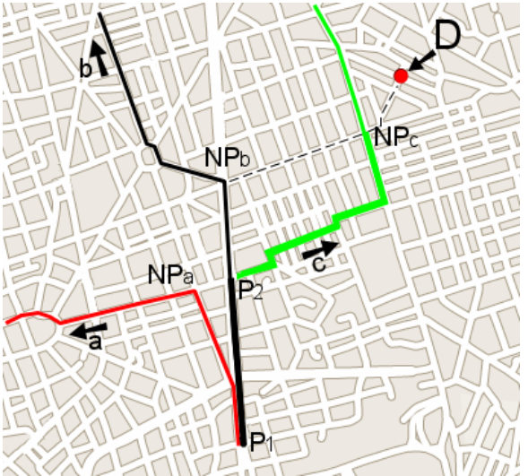
GeOpps: Geographical Opportunistic Routing
Assumes that cars know in advance their trajectory
  Using some navigation, travel planner software
Next hop selected in three steps:
  Each neighbor calculates for its trajectory the closest point to the destination
  It calculates how much time it takes to that closest point
  If the trajectory of one of the neighbors gets closer to the destination than that of the current node, then the packet is taken over
If the car changes its trajectory, everything should be recalculated

Slide 5
VANET broadcast protocols
We have a target zone, within which all the vehicles should receive the message (Broadcast Domain)
  However, the load on the network should be minimized, (avoid broadcast storms)
DECA: Density-Aware Reliable Broadcasting
  Does not use position information
  Beacon messages sent to discover neighbors
  Network load is minimized by chosing as next hop the neighbor that has most neighbors

Slide 6
Intelligent flooding through gossiping
Messages are rebroadcast or dropped with a given probability p
  Carefully Localized Urban Dissemination (CLoUD)
The drop probability on a given road segment depends on the probability of cars on that segment heading towards the source of the flooding (where the danger was detected)
Needs a traffic database
  Turn probabilities at each intersection
  Stop probability on each segment
  Average traffic density in different periods of the day
Increasing reliability with a voting mechanism
  The message is dropped only if there are sufficent votes to drop it
Miklos Mate, Rolland Vida, „Reliable Gossiping in Urban Environments”, in Proceedings of 72nd IEEE Vehicular Technology Conference VTC-Fall, Ottawa, Canada, September 2010.

Slide 7
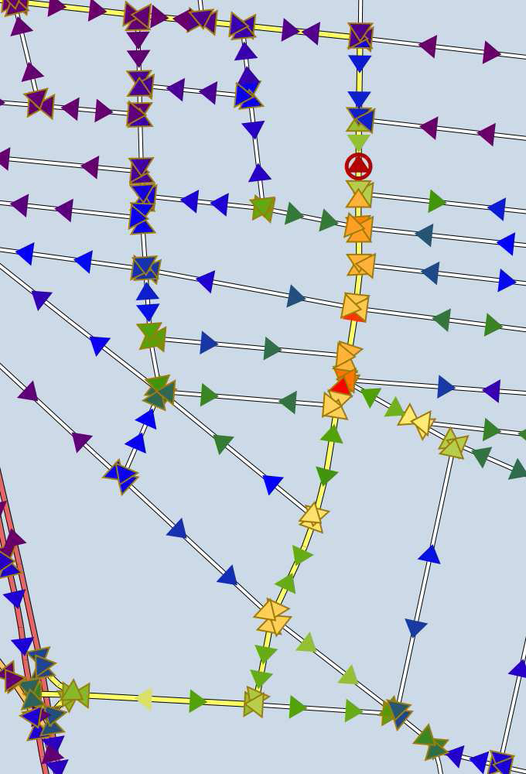
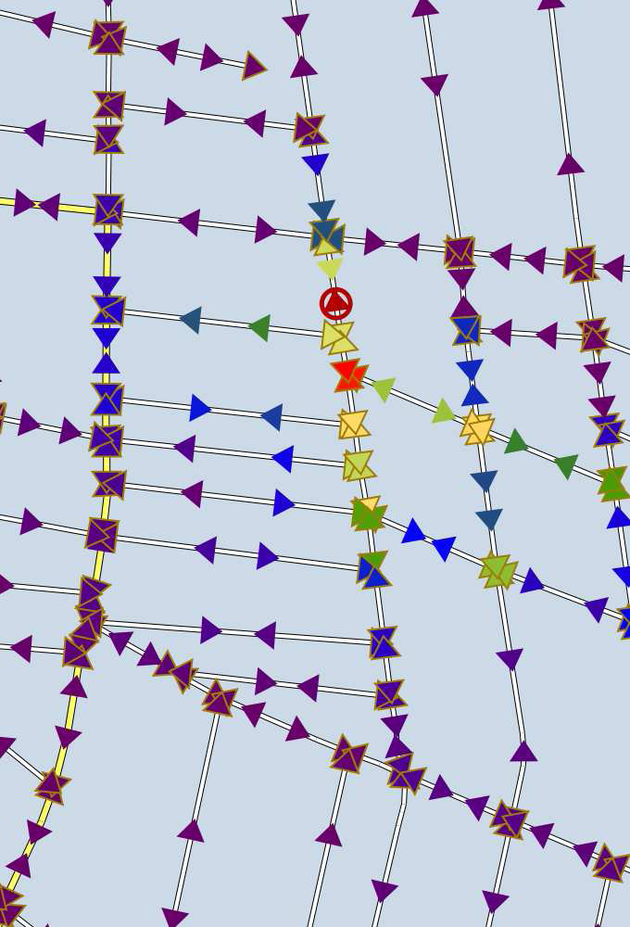
Intelligent flooding through gossiping
Simulation results for the CLoUD protocol
  Digital map of Budapest, warmer colors mean more messages received by that car
  If the problem occurs on a main road (left), the message is spread more broadly
  If the problem occurs on a side road (right), the flooding dies out fast

Slide 8
VANET Multicast protocols
There is a given area inside which all cars should receive the message (Zone of Relevance)
The multicast group is implicitely defined by the position of the cars
The source is not necessarily inside the ZOR, so first the packet should be delivered to the ZOR, through unicast routing, and then flood the ZOR
  E.g., information about traffic jam is not interesting for those already in the jam
  The alert should be sent to those who can still avoid it

Slide 9
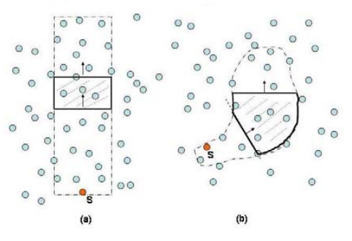
Mobicast
Mobile Just-in-time Multicasting
The Zone of Relevance, or Delivery Zone, moves with a given speed
  E.g., give way to the ambulance
We should ensure that within some space-time coordinates, each car that enters the Delivery Zone should receive the message before it enters the zone, or just on entering the zone

Slide 10
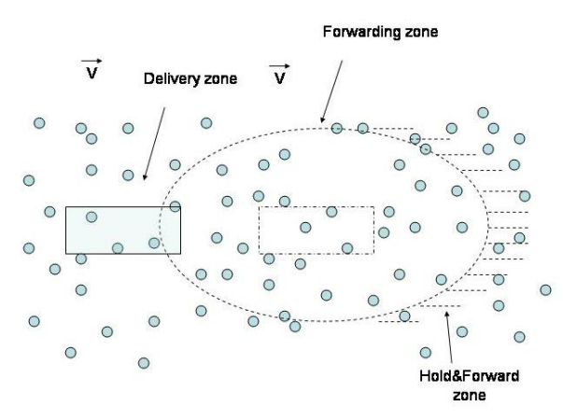
Mobicast
Forwarding Zone
  Preceeds the Delivery Zone
  Nodes in this zone rebroadcast the message
Hold&Forward Zone
  They only store the message, and retransmit it only when entering the Forwarding Zone

Slide 11
Communication architectures
Car-to-Car (C2C) or Vehicle-to-Vehicle (V2V)
  Cars communicate directly among each other
Car-to-Infrastructure (C2I) or Vehicle-to-Infrastructure (V2I)
  Communication among cars and the deployed infrastructure
  Mobile base stations
  Sensors, data storage, gateways deployed next to the road
    RSU – Road Side Unit
Car-to-Pedestrian
  In between C2C and C2I
    Different mobility models

Slide 12
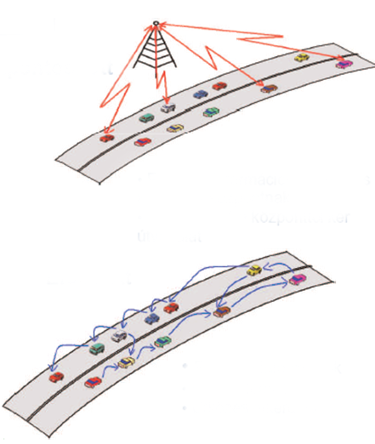
Communication architectures
 | Centralized | Distributed
Coverage/range | ☺ Complete | ☹ Low, separated islands
Speed | ☹ | ☺
Reliability | ☺ | ☹ collisions, interferences
Capacity | ☹ limited | ☹ limited
Price | ☹ yes | ☺ no
Centralized
Traffic data is periodically sent to the central database
Cars receive traffic information from the central database
Distributed
Traffic data
Ad hoc tempomat
Collision avoidance

Slide 13
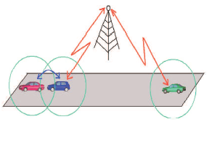
Hybrid solutions
Some cars can communicate with the central entitty, through the mobile network
  E.g., LTE
Others communicate only with each other
  They can not, or do not want to communicate with the central entity

Slide 14
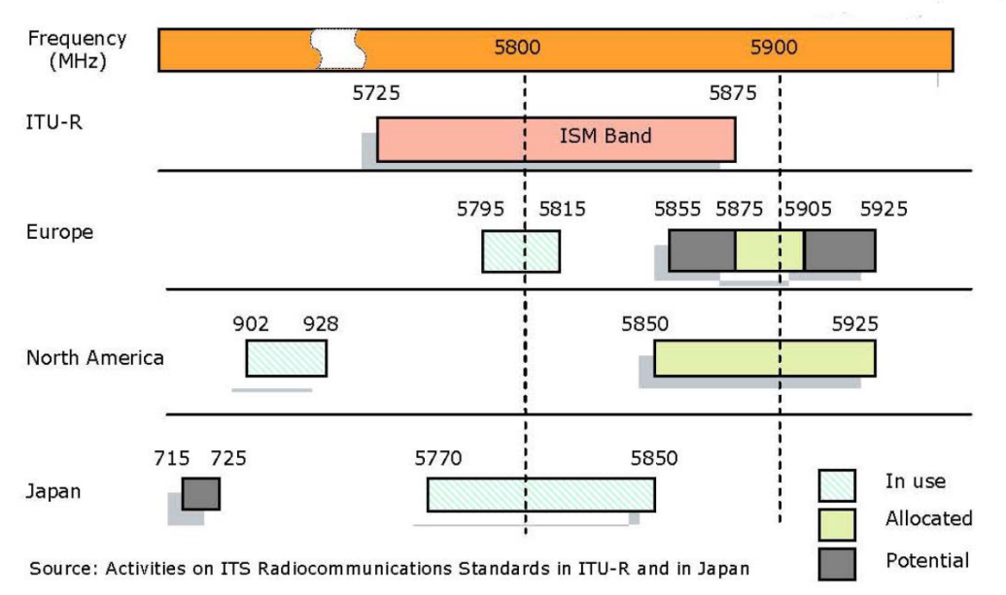
DSRC – Dedicated Short Range Communications
Dedicated in 1999 by the FCC (Federal Communications Commission) to vehicular communications
  75 MHz of spectrum in the 5.9 GHz band (5.850-5.925 GHz)
In Europe, ETSI allocated in 2008 30 MHz in the 5.9 GHz band for ITS
Systems in US, Europe, Japan not really compatible with each other

Slide 15
DSRC – Dedicated Short Range Communications
Traditional ISM bands (Industry, Science, Medical) – 900 MHz, 2.4 GHz, 5 GHz
  Free, unlicenced bands
  Populated by many technologies – Wifi, Bluetooth, Zigbee
  No restrictions other than some emmission and co-existance rules
DSRC band
  Free but regulated spectrum
  Restrictions in terms of usage and technologies
  All radios should be compliant to a standard

Slide 16
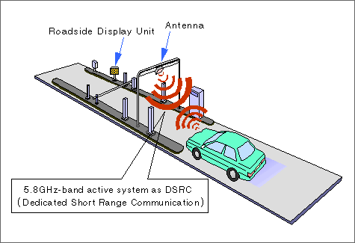
DSRC – Dedicated Short Range Communications
Basic goals of DSRC
  Support of low latency, secure transmissions
  Fast network acquisition, rapid and frequent handover handling
  Highly robust in adverse weather conditions
  Tolerant to multi-path transmission
Mainly for public safety applications, to save life and improve traffic flow
Private services also permitted
  Spread the deployment costs, encourage quick development and adoption
  Electronic Toll Collection (ETC) was initially one of the main drivers

Slide 17
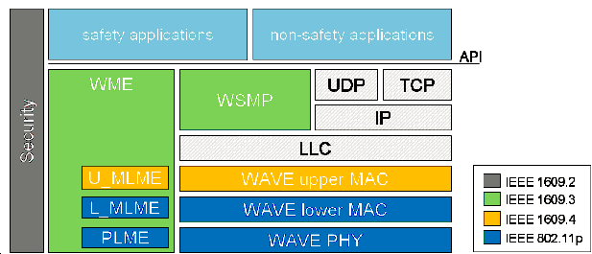
WAVE
IEEE 802.11
  Collection of physical (PHY) and medium-access control (MAC) layer specifications for implementing WLAN
  802.11a (5 GHz, OFDM), 802.11b (2.4 GHz, DSSS), 802.11g (2.4 GHz, OFDM), 802.11n (2.4 and 5 GHz, MIMO-OFDM), 802.11ac (5 GHz, MIMO-OFDM)
  802.11p – part of WAVE (Wireless Access in Vehicular Environment)
WME – WAVE Management Entity
PLME – Physical Layer Manag. Entity
MLME – MAC Layer Manag. Entity
LLC – Logical Link Control
WSMP – WAVE Short Message Prot.

Slide 18
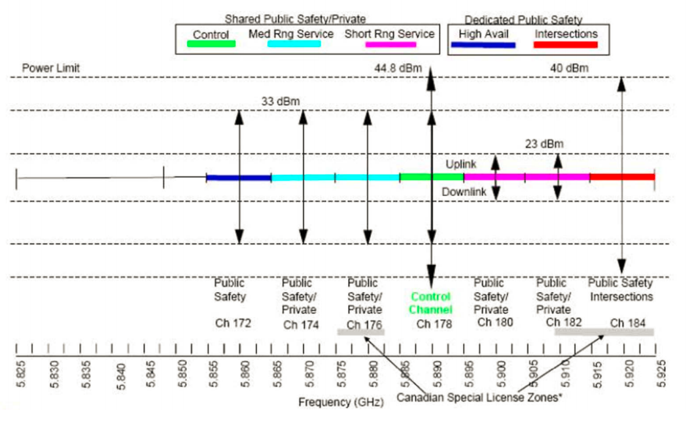
WAVE spectrum bands
75 MHz wide spectrum divided into 7x10 MHz wide channels, 5 MHz guard band
  Channel 178 the control channel (CCH) - transmit WAVE Short Messages (WSM), announce services
  Channel 172 reserved for high availability applications (future use)
  Channel 184 reserved for intersections
  The other channels shared between public safety and private uses
    Channels 174-176 and 180-182 can be
    combined to form a 20 MHz channel
In Europe the ITS-G5 standard
  ITS-G5B band: 5.855 – 5.875 GHz
    172, 174 SCH – ITS non-safety app
  ITS-G5A band: 5.875 – 5.905 GHz
    176, 178 SCH – ITS traffic safety app
    180 CCH
  ITS-G5D band: 5.905 – 5.925 GHz
    182, 184 SCH – for future use

Slide 19
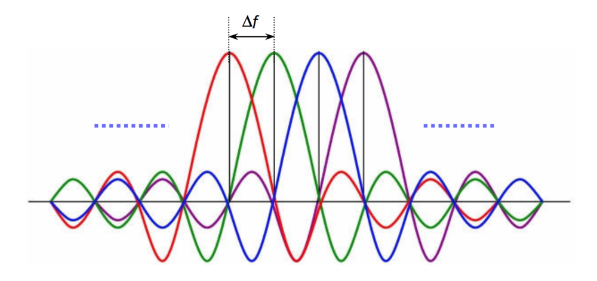
WAVE (802.11p) vs IEEE 802.11
10 MHz channels instead of 20 MHz
3-27 Mbps instead of 6-54 Mbps
Same modulation schemes (BPSK, QPSK, 16QAM, 64QAM)
Carrier spacing reduced to 0.15625 MHz from 0.3125 MHz
  48 data subcarriers for both

Slide 20
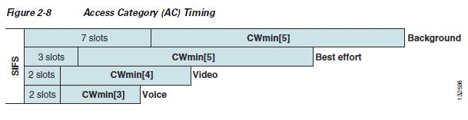
802.11p MAC
Enhanced Distributed Coordination Access (EDCA)
  Defined in IEEE 802.11e, to support Quality of Service differentiation
    In 802.11e four Access Categories (AC) – Voice, Video, Best Effort and Background
    In 802.11p ACs to differentiate between safety critical and non-safety applications
  Arbitration Inter-Frame Spacing to replace the static DIFS
    Different values for each Access Category
    AIFS = 1 SIFS + AIFSN * slot time
    By default…
      Voice Queue 1 SIFS + 2 * slot time (AIFSN = 2)
      Video Queue 1 SIFS + 2 * slot time (AIFSN = 2)
      Best Effort Queue 1 SIFS + 3 * slot time (AIFSN = 3)
      Background Queue 1 SIFS + 7 * slot time (AIFSN = 7)
    When AIFS expires, choose a random value between 0 and CWmin (minimum contention window)
    Start decrementing a backoff timer after each slot time
    If another node starts transmitting, access is deferred until the channel is free again
    Then backoff timer decrementation is resumed from where it was stopped
    If backoff = 0, transmission starts
    If collision, no ACK received – CWmin is doubled until it reaches CWmax

Slide 21
802.11p beaconing
Basic Service Set in traditional IEEE 802.11
  Multiple handshakes to ensure distributed medium access
Wave Basic Service Set (WBSS) in 802.11p
  A node broadcasts a beacon, to advertise its WBSS
  What kind of services it supports, how to join the WBSS
Within the WBSS, nodes exchange beacons using the Wave Short Message Protocol (WSMP)
  To create cooperative awareness
  Information on speed, position, acceleration, direction
  Sent at regular intervals (e.g., 10 Hz – 100 ms)
Sent on the CCH, no ACK
  After the channel is sensed free for AIFS
  If not free, backoff for the size of a Contention Window, and try again
  No doubling of the contention window
As opposed to data sent on SCH, where ACK should be sent
  If no ACK received, collision occured, contention window doubled

Slide 22
IEEE 1609.x
IEEE 1609.2 – security services
IEEE 1609.3 – management services
  Channel usage monitoring
  Received channel power indicator (RCPI)
  Management parameters
IEEE 1609.4 – QoS and multi-channel access
  User Priorities mapped to Access Categories in EDCA
  Multi-channel access for single radio 802.11p devices

Slide 23
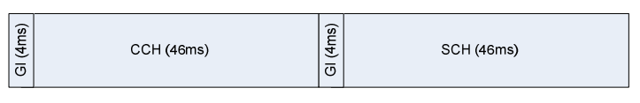
IEEE 1609.4 channel swithcing
7 FDMA channel frequencies
Multi-channel radios can send and receive over several channels simultaneously
Single channel radios to access both CCH and SCH
  Either transmit or receive on a single 10 MHz channel
Alternating access
  Repetitive periods of 100 ms
    46 ms allocated to the CCH channel
    46 ms allocated to the SCH channels
    4 ms guard interval for switching between CCH and SCH
      Nodes should wait for a random backoff after the end of the guard interval, before starting to transmit
  Time synchronisation needed to an external time reference
    Coordinated Universal Time (UTC) from GPS or other devices
      WAVE Time Advertisement (WTA) frame

Slide 24
IEEE 1609.4 channel switching
Continuous access
  Transmission can be continuous on the CCH and all SCHs
  It cannot be guaranteed that all other stations will listen to the CCH outside the CCH slot
  Safety messages sent over the CCH in the SCH slot might be ineffective
  The usage of SCH not efficient if nodes listen to the CCH 50% of the time
Alternative solutions to minimise the impact of channel switching?

Slide 25
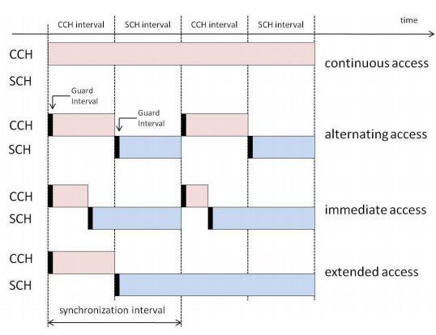
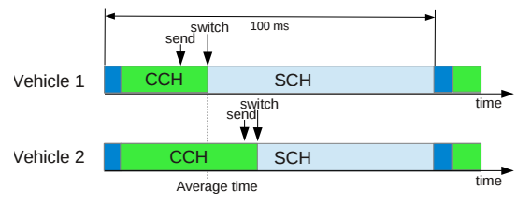
IEEE 1609.4 channel switching
Immediate access
  The node does not have to wait until the CCH slot is over
  After the CCH transmission is over, switch to SCH
  Improve the performance of bandwidth-demanding non-safety
  applications in SCH, at the expense of the CCH
Extended access
  Transmission on the SCH without waiting for the CCH
Adaptive Independent Channel Switching
  If more vehicles, more beacons on the CCH
  Nodes can change their average switching time based on vehicle density
    Long SCH intervals if not many vehicles
    Fewer collisions at the start of the SCH, as nodes switch independently of each other
  Drawback is that not all nodes on the CCH in the same time
    Vehicle 1 will miss the beacon of Vehicle 2

Slide 26
IEEE 1609.4 channel switching
Fragmentation
  To better utilise the residual time at the end of the SCH interval
  An extra fragmentation header should be used, which is a drawback
  Works for large packets (TCP)
Best-fit scheme
  Send the packet that best fits the residual time at the end of the SCH interval
    Better than fragmentation only if packets of different sizes are present in the queue
  Hard to know in advance the actual duration of transmission
    Frequent changes in the channel congestion
    Stochastic nature of backoff

